Slide 1
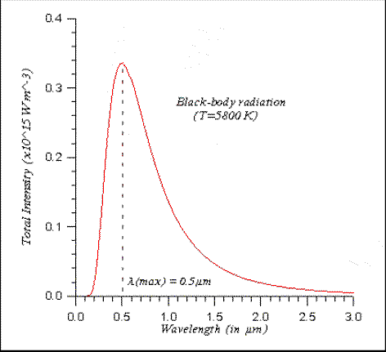
Physics 2 – Mar 13, 2020
Do Now – Determine the temperature of this black body if _{max} = 0.50 μm.
Get out 26 – 35 for
HMK check.

Slide 2
Objectives/Agenda/Assignment
Objective:
8.2 Thermal Energy Transfer
Assignment: 8.2 p338 #36-44
Agenda:
Homework Review
Solar Radiation
Albedo and Energy Balance
Greenhouse Effect

Slide 3
Solar radiation
The thermal power of the sun (the rate of energy production of its nuclear fission reactions) is P = 3.9 x 10²⁶ W
The intensity of the sun’s radiation at the location of earth (that is at a distance of 1.5 x 10¹¹ m = the earth – sun distance) is given by
$I=\frac{P}{4πd^{2}}$ Recall radiation intensity is power over surface area
Result is the intensity of the sun at the earth, S = 1360 W/m² and is called the solar constant (Listed as a constant in the data booklet)

Slide 4
Intensity of sun on earth surface
Recall I = P/A or to rearrange P = IA
At the surface of the earth (with a radius R) P = SR²
We only receive the energy cut by the disc of A = R²
Because we are spinning this intensity is distributed over the entire surface of the earth.
The intensity at the surface is the P/A for the surface area of the earth 4R² I = SR² / 4R² = S/4 = 340 W/m²
But this neglects the energy reradiated by the earth because it is also a black body radiator. This effect is described by the concept of albedo

Slide 5
Albedo
Albedo is the ratio of the total scattered power (reradiated/reflected) to the total incident power (portion of S we receive through our shadow disc)
Given the symbol  and ranges from 0 (perfect absorber) to 1 (perfect reflector)
Albedo varies over the surface of the earth from charcoal (0.04) to snow (0.85)
Average albedo for the earth  = 0.30.
So only 70% or (1 – ) of the intensity of the sun (S/4) that reaches the earth is delivered.
$I_{ave}=\frac{\left(1−α\right)S}{4}=245 W/m^{2}$

Slide 6
Greenhouse Effect
If we assume all radiation that is reradiated reaches space we calculate the average temperature of the earth to be -17C but we observe it to be 15C.
The 32C difference reflect the amount of heat trapped by our atmosphere. = Greenhouse Effect
Greenhouse gases include water, carbon dioxide, methane and nitrous oxide.
There are both natural and manmade (anthropogenic) sources of these greenhouse gases.

Slide 7
Energy Balance Diagrams
Arrow thickness represents the amount of energy transferred.
If the amount of down arrows balance the up arrows then no net energy is delivered to Earth. Balance is roughly what we observe.
A small net difference in the total amount of intensity delivered (down arrows) versus the intensity reradiated (up arrows) reflects global warming.

Slide 8
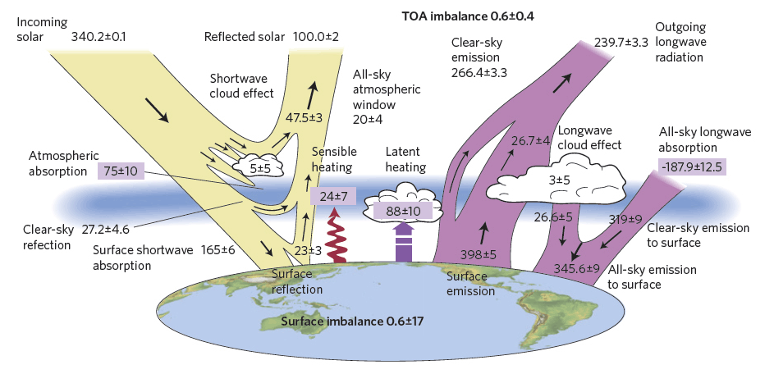
Energy Balance Diagrams
Complexity of the system creates disagreement about where the source of the small net difference is located.

Slide 9
Hints for #39 in the HMK
A) Asked to solve for three variables, I₁, I₂ and I₃.
Therefore you need three equations in those variables.
1) “Only a fraction t of the energy radiated by the Earth (I₁)actually escapes the Earth (I₃)” allows you to express I₃ in terms of I₁.
2) Write the energy balance equation for the earth (the ground) by setting all arrows income to earth = all arrows exiting earth. (Hint: one side will be I₁.)
3) Write the Energy balance equation for the atmosphere (middle of diagram). (Hint: one side will be I₁(1-  ).
Then ALGEBRA to solve for I₁, I₂ and I₃.

Slide 10
Hints for #39 in the HMK
B) Demonstrate the energy balance for the Space.
C) Calculate t using the radiation Power equation. Assume the earth is a black body.
D) i) For some incident intensity I, some gets reflected, some gets absorbed and some gets transmitted.
I reflected is I based on definition of albedo
I absorbed is eI based on the definition of emissivity
I transmitted is tI based on the info given in the problem
ii) Use the data determined in the rest of the problem to calculate the answer again using the radiation Power equation.

Slide 11
Exit Slip - Assignment
Exit Slip- none
What’s Due? (Pending assignments to complete.)
8.2 p338 #36-44
What’s Next? (How to prepare for the next day)
Start studying for the Thermodynamics test on March 26 (Tentative)

